Slide 1
6CS029 – Advanced Networks Lecture 1 Routing and WAN Design (Principles and Practice)

Slide 2
Introduction to module
Who is teaching this Module?
Dr Consolee Mbarushimana
Dr Ian Coulson (module leader)
When
Online lecture 10 to 11am Thursday
workshop and surgery 11am to 2pm Thursday
How is it assessed – by 2 components
50% exam
50 % a) 6 workshops (which contribute 40% of this mark)
b) a series of related research questions (which contribute the further 60%) (note resit and retake students hava different piece of work for this)

Slide 3
Routing
Each node in WAN is router accepts input packet, examines destination address, and forwards packet on to telecommunications line.
Question: How does router decide which line to transmit on?
Answer: Router must select one transmission line to provide path to destination in optimal manner. Often many possible routes exist between sender and receiver.

Slide 4
Routing
Subnet with vertices and telecommunication links is essentially weighted network graph.
Telecommunication links between vertices have cost associated with them.
Cost could be delay cost, queue size cost, limiting speed, or simply financial amount for using that link.

Slide 5
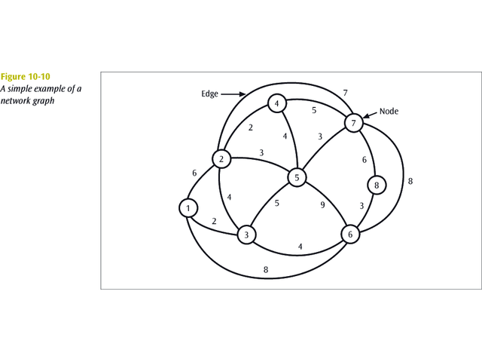
A simple example of a network graph
Note: the use of the words Vertex (Node) and Edge (link)

Slide 6
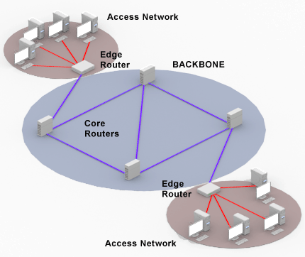
Backbone and Access Networks
WANs can be split into two parts
Backbone network linking main centre
Access networks linking endpoints to nearest backbone node
Both aspects of the network need design
Different rules apply to each type

Slide 7
WAN Design
Wide area networks constructed from private circuits (leased lines) need careful design to:
optimise performance
minimise costs
provide adequate service
allow redundancy for fault tolerance

Slide 8
Some Definitions
C
Graphs
A,B,C etc. are vertices
(A,X), (X,Y) etc. are edges
P,Q,Z is a cycle (loop)‏
Degree of a node is the number of edges at the node
Degree Y =3, degree C=1
B
Y
P
Q
X
A
Z
D

Slide 9
Trees
A tree is a connected simple graph with no cycles e.g.
B
C
P
Q
Y
X
A
Z
D

Slide 10
Star
A tree is a star if only 1 vertice has degree >1
B
C
P
Y
Q
X
A
Z
D

Slide 11
Chains
A chain is a tree with no vertices of degree >2
B
C
P
Q
Y
X
A
Z
D

Slide 12
Routing
Routing method, or algorithm, chosen to move packets through network should be:
Optimal, so least cost can be found.
Fair, so all packets may be treated equally.
Robust, in case link or node failures occur and network has to reroute traffic.
Not too robust so that chosen paths do not oscillate too quickly between troubled spots.
Similar to your Satnav giving you a choice of routes, Fastest, Shortest or Eco-friendly

Slide 13
Some Routing Algorithms
Dijkstra *
Flooding
Central
Distributed
Isolated
Adaptive
Static

Slide 14
Dijkstra’s Least Cost Routing Algorithm
Dijkstra’s least cost algorithm finds all possible paths between two locations.
By identifying all possible paths, it also identifies least cost path.
The algorithm can be applied to determine least cost path between any pair of vertices.
OSPF which has become the most common used interior routing protocol uses this algorithm.

Slide 15
Dijkstra’s method
Label the start vertex with permanent label 0 and order label 1
Assign temporary labels to all the vertices that can be reached directly from the start
Select the vertex with the smallest temporary label and makes its label permanent. Add the correct order label
Put temporary labels on each vertex that can be reached directly from the vertex you have just made permanent. The temporary label must be equal must be equal to the sum of the permanent label and the direct distance from it. If there is an existing temporary label at a vertex, it should be replaced only if the new sum is smaller.
Select the vertex with the with the smallest temporary label and makes its label permanent. Add the correct order label.
Repeat until the finishing vertex has a permanent label.
To find the shortest path, trace back from the end vertex to the start vertex. Write the routes forwards and state the length.
You tube video of Dijkastra's algorithm

Slide 16
Find The SPT between A and E using Dijkstra’s method
2 | 4
4
12 | 6
12
7 | 19
25, 19
8
7
B
C
D
4
9
1 | 0
0
2
14 | 7
15 14
4
E
8 | 21
21
11
14
A
I
7
6
8
10
2
G
F
H
1
3 | 8
8
5 | 11
11
4 | 9
9

Slide 17
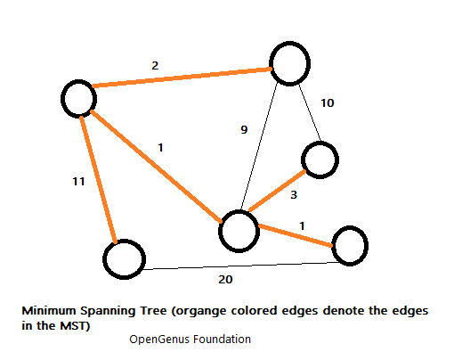
MST
Given a connected, undirected graph, a spanning tree of that graph is a subgraph that is a tree and connects all the vertices together. A single graph can have many different spanning trees.
We can also assign a weight to each edge, which is a number representing how unfavourable it is, and use this to assign a weight to a spanning tree by computing the sum of the weights of the edges in that spanning tree.
A minimum spanning tree (MST) is then a spanning tree with weight less than or equal to the weight of every other spanning tree.

Slide 18
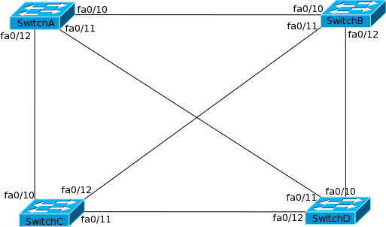
Spanning tree protocol
In this scenario suppose a broadcast comes from a pc attached to switch A, and this will broadcast it out on all ports to all switches it is connected to.
Who then broadcast it out on all ports except the one it received it on, and receiving switches will do the same.
It is not hard to see that switch A will eventually receive it on ports Fa0/11 and 12 and will broadcast it out again on port 10 and so it will go on – infinite loop

Slide 19
Spanning tree protocol
STP allows bridges and switches to communicate with each other so they can create a loop free topology.
Each bridge runs the Spanning Tree Algorithm that calculates how a loop can be prevented.
When STP is applied to a looped LAN topology, all segments will be reachable but any open ports that would create a traffic loop are blocked.
continually monitors the network always looking for failures on switch ports or changes in the network topology.

Slide 20
MST applications
Many possible applications in real world, designing sewers, fresh water pipes distribution network, and in networks and Telecomms
One example would be a British Telecom that needs to connect all it’s local Primary Connection Points (green or grey cabinets on street corners) to the exchange.
Some of those paths might be more expensive, because they are longer, or require the cable to be buried deeper; these paths would be represented by edges with larger weights.
A spanning tree for that graph would be a subset of those paths that has no cycles but still connects to every cabinet. There might be several spanning trees possible. A minimum spanning tree would be one with the lowest total cost.

Slide 21
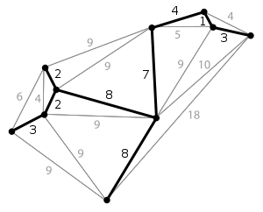
the darker links form the MST for this graph

Slide 22
Finding the MST
Greedy algorithms
A greedy algorithm is an algorithmic strategy that makes the best optimal choice at each small stage with the goal of this eventually leading to a globally optimum solution. This means that the algorithm picks the best solution at the moment without regard for consequences. It picks the best immediate output, but does not consider the big picture, hence it is considered greedy
In many problems, a greedy strategy does not in general produce an optimal solution, but nonetheless a greedy method may yield locally optimal solutions that approximate a global optimal solution in a reasonable time.
Kruskal’s
Arrange the edges by weight: least weight first and heaviest last.
Choose the lightest not examined edge from the diagram. Add this chosen edge to the tree, only if doing so will not make a cycle.
Stop the process whenever n - 1 edges have been added to the tree.
Kruskal's algorithm

Slide 23
8
7
B
C
D
4
9
2
11
4
14
E
A
I
7
6
8
10
2
G
F
H
1

Slide 24
Solution using Kruskal’s method
Step 1 Arrange the edges by weight: least weight first and heaviest last.
Step 2 Choose the lightest not examined edge from the diagram. Add this chosen edge to the tree, only if doing so will not make a cycle.
8
7
{GH} = 1
{FG} = 2
{CI] = 2
{AB} = 4
{CF} = 4
{GI} = 6
{CD} = 7
{HI} = 7
{AH} = 8
{BC} = 8
{DE} = 9
{EF} = 10
{BH}= 11
{DF} = 14
B
C
D
4
9
2
Reject because of cycles
{GI} = 6
{HI} = 7
Accept
{GH} = 1
{FG} = 2
{CI] = 2
{AB} = 4
{CF} = 4
{CD} = 7
{BC} = 8
{DE} = 9
11
4
14
E
A
I
7
6
8
10
G
2
F
STOP
All nodes are reached
H
1
MST cost = 37
Step 3 Repeat step 2 and stop the process whenever n - 1 edges have been added to the tree.

Slide 25
Steps of Prim's Algorithm:
Begin with any vertex which you think would be suitable and add it to the tree.
Find the lowest weighted edge that connects any vertex in the tree to any vertex that is not in the tree. Note that, we should not form cycles.
Stop when n - 1 edges have been added to the tree.
Prim's Algorithm

Slide 26
8
7
B
C
D
4
9
2
11
4
14
E
A
I
7
6
8
10
2
G
F
H
1

Slide 27
Find the MST using Prims method
8
7
Begin with any vertex which you think would be suitable and add it to the tree.
Find the lowest weighted edge that connects any vertex in the tree to any vertex that is not in the tree. Note that, we should not form cycles.
Stop when n - 1 edges have been added to the tree.
B
C
D
4
9
2
11
4
14
E
A
I
We have selected the CD as the initial one. We repeat step 2 until every node is reached
7
6
8
10
G
2
F
CD=7
H
1
CI=2
We could at this point select either BC or AH. I have chosen BC.
CF=4
GF=2
HG=1
BC=8
AB=4
DE=9
MST = {CD, CI, CF, GF, HG, BC, AB, DE} = 37

Slide 28
Summary
Design will depend on traffic, costs, and other desirable parameters such as utilisation
Design methods for Access and backbone are different
Many algorithms are available
Real networks will require careful cost minimisation

Slide 29

Questions and Answers

